Slide 1



EV Vehicle/Charging Demand Prediction
Harshitha Nuka
AICTE Student ID: STU682aa7117426b1747625745
AICTE Internship ID: INTERNSHIP_175040797468551b2636342

Slide 2

Learning Objectives
Analyze electric vehicle (EV) adoption using real-world government data.
Apply machine learning techniques for time series forecasting.
Perform data cleaning, transformation, and visualization.
Engineer meaningful features like lags, trends, and rolling averages.
Build and evaluate predictive models using regression techniques.
Interpret model results and understand forecasting metrics.
Create and deploy an interactive dashboard using Streamlit.
Compare EV adoption trends across multiple regions (counties).
Gain experience in working with end-to-end AI/ML pipelines
GOAL
Source :
www.freepik.com/

Slide 3
Tools and Technology used
Languages & Libraries
Programming language- python
Data processing - pandas, Numpy
Machine learning - scikit-learn
Data visualization - matplotlib
Model handling & support - Joblib, TensorFlow
Development & Deployment
Model development - Jupyter Notebook
Interactive web dashboard - Streamlit
Environment
VS Code
Data Source
EV registration data from *Washington State (USA)

Slide 4
Methodology
1. Data Collection
Collected EV registration data by county from Washington State.
2. Data Preprocessing
Handled missing values and parsed date formats. Encoded categorical features like county names.
3. Feature Engineering
Created lag features, rolling means, growth percentages, and trend slopes.
4. Model Building
Trained a machine learning model (Random Forest) using engineered features.
5. Forecasting
Predicted EV adoption for the next 3 years on a monthly basis.
6. Visualization
Plotted cumulative EV adoption trends for individual and multiple counties.
7. Deployment
Built an interactive dashboard using Streamlit to display predictions and comparisons.

Slide 5
Problem Statement:
Despite growing interest in electric vehicles, government planners and stakeholders lack tools to:
Understand current EV adoption trends at a regional level.
Predict future EV growth for planning infrastructure and policy.
Visualize adoption patterns across different counties.
Objective:
To build a machine learning model that forecasts EV adoption over the next 3 years, and present the results through an *interactive, user-friendly dashboard.

Slide 6
Solution:
Developed a machine learning model using historical EV data.
Engineered time-based features to capture growth trends.
Used Random Forest Regression to forecast EV adoption for each county.
Built a Streamlit web app to interactively visualize forecasts.
Enabled users to: Select a county and view its EV growth trend.
Compare EV adoption forecasts across up to 3 counties.
Analyze projected growth over a 3-year period.
GIT HUB REPOSITORY LINK:
https://github.com/Harshitha-Nuka/EV_charging_prediction.git

Slide 7
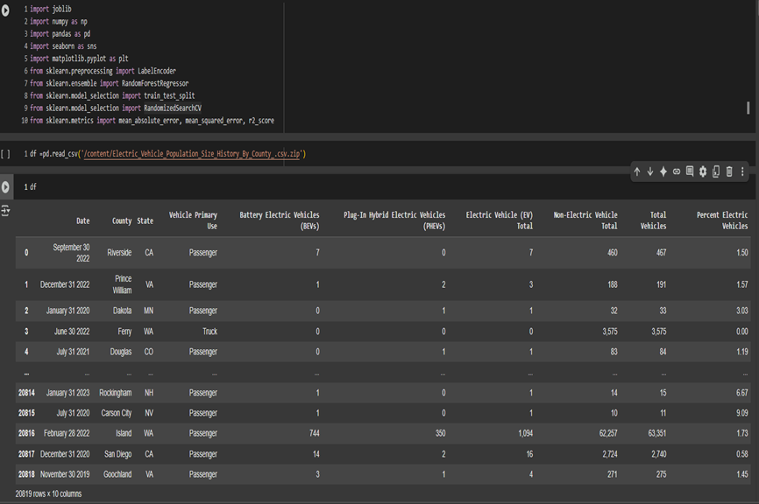
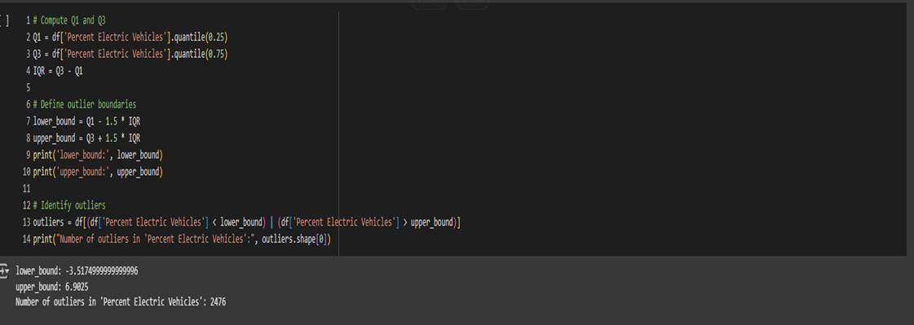
Screenshot of Output:

Slide 8
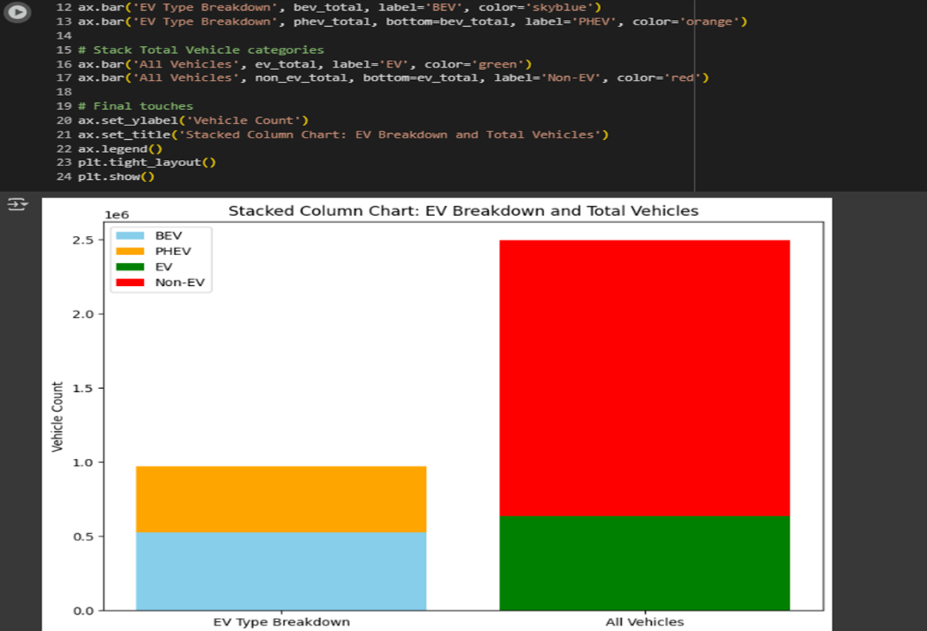
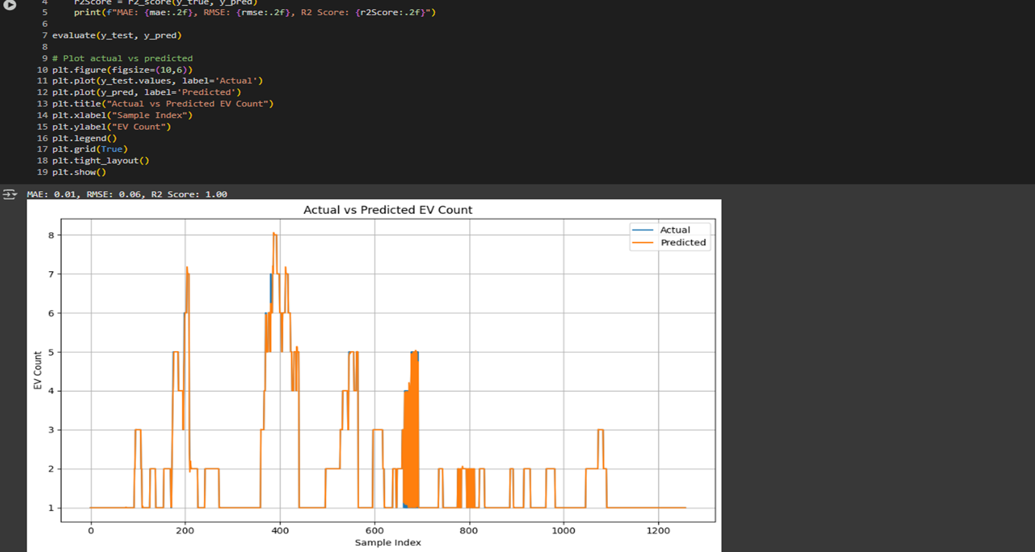
Screenshot of Output:

Slide 9
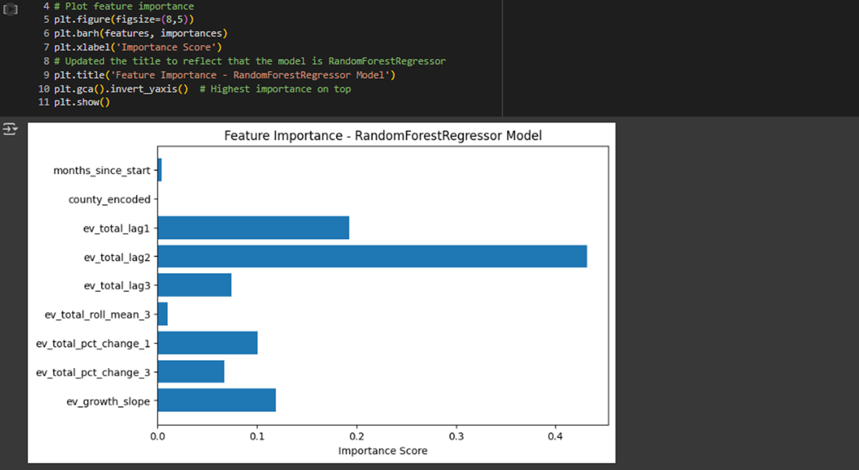
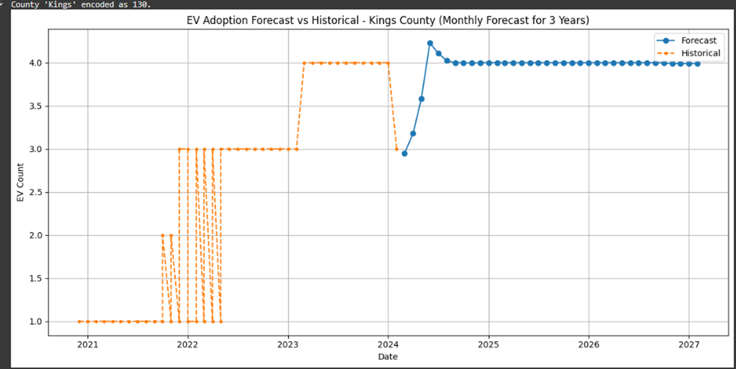
Screenshot of Output:

Slide 10
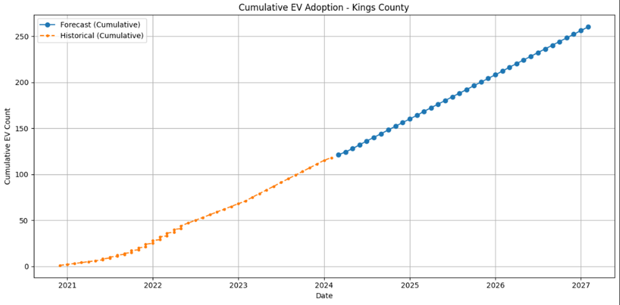
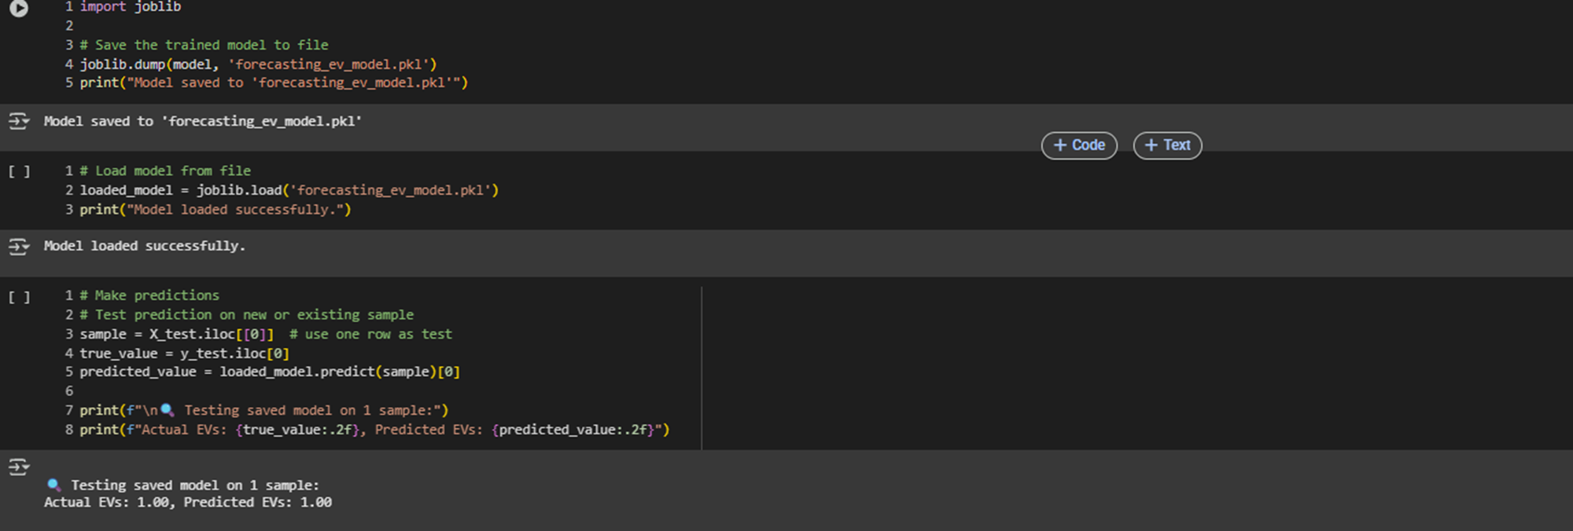
Screenshot of Output:

Slide 11
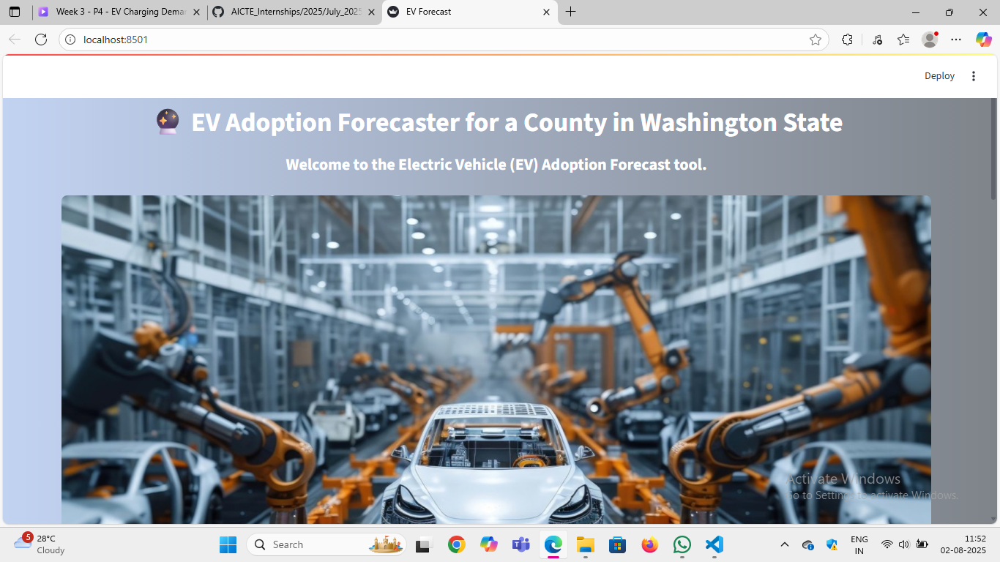
Screenshot of Output:

Slide 12
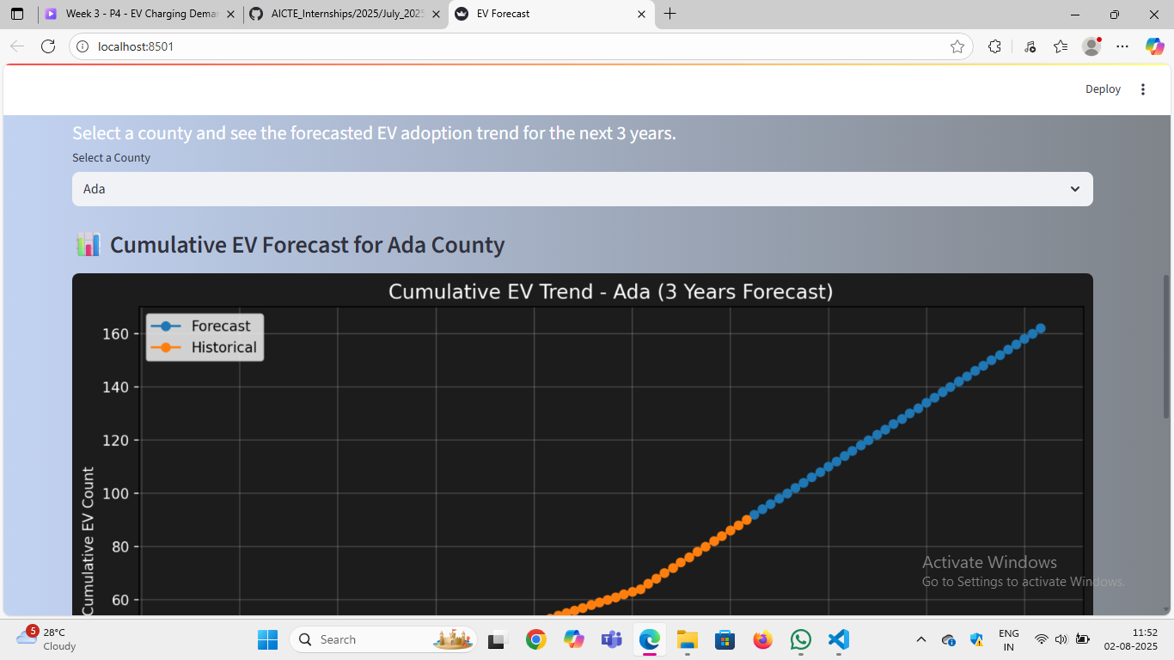
Screenshot of Output:

Slide 13
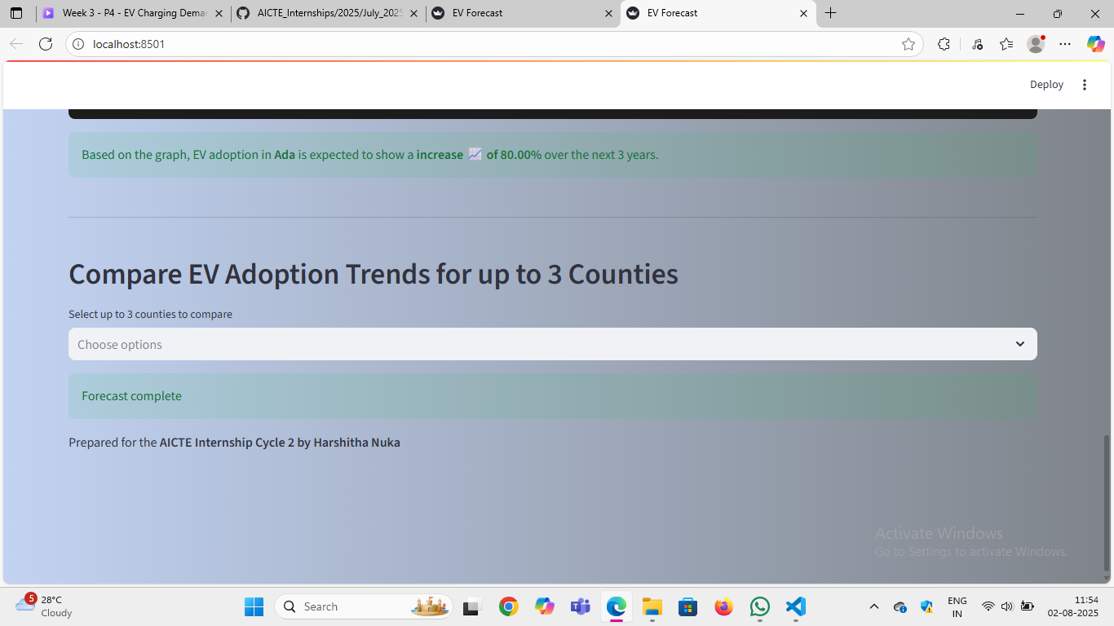
Screenshot of Output:

Slide 14
Conclusion:
Successfully built a machine learning model to forecast EV adoption using real-world data. ​
Applied key ML concepts: preprocessing, feature engineering, and regression modeling. ​
Deployed results through an interactive Streamlit dashboard. ​
Enabled data-driven insights for regional planning and decision-making.​
Demonstrated the practical impact of AI/ML in solving real-world environmental and policy challenges.​

